Slide 1
IBM GROUP 5 CLOUD COMPUTING phase-4
DISASTER RECOVERY WITH IBM CLOUD VIRTUAL SERVERS

Slide 2
DEVELOPMENT PART - 2

Slide 3
Types of Disaster Recovery Solutions
1. Data Center Disaster Recovery
Organizations with proprietary data centers must implement a disaster recovery strategy that addresses all IT infrastructure components in the data center and the surrounding physical facility. This strategy typically centers on backups to failover sites housed in secondary data centers or co location facilities. Business and IT leaders should document the various components of these physical facilities, including heating, cooling, power, fire response, and security controls.
2. Network Disaster Recovery
Network connectivity is critical for external and internal communication, application access, and data sharing in the event of a disaster. The network disaster recovery strategy should detail a plan to restore network services and ensure access to backup data and secondary storage sites.
3. Virtualized Disaster Recovery
Organizations can use virtualization to replicate workloads in a secondary location or cloud environment for disaster recovery. Virtualized DR is flexible, easy to implement, fast, and efficient—virtualized workloads have small IT footprints, support frequent replication, and enable fast failover initiation. Various data protection vendors provide virtual DR and backup products.

Slide 4
4. Disaster Recovery in the Cloud
With many cloud services available, organizations can host DR systems in a cloud environment rather than in a physical location. Cloud disaster recovery involves more than cloud backup. IT teams must configure automatic workload failover to the DR cloud platform for immediate recovery when a disruption occurs.
5. Disaster Recovery as a Service (DRaaS)
DRaaS is a commercially available cloud DR service that allows an organization to replicate and host its virtual and physical servers on a third party’s infrastructure. The DR service provider is responsible for implementing the disaster recovery plan during a crisis based on the service-level agreement.
There are various disaster recovery providers, given that DR extends beyond IT. Some vendors sell backup and disaster recovery tools, while others offer fully managed or hosted DR services. Disaster recovery also encompasses risk management, so some vendors provide additional security features such as emergency plans and incident response.

Slide 5
4.What is Disaster Recovery in the Cloud?
The term cloud disaster recovery (cloud DR) refers to the strategies and services enterprises apply for the purpose of backing up applications, resources, and data into a cloud environment.
Cloud DR helps protect corporate resources and ensure business continuity. If disaster hits, enterprises can restore data from backed up versions to either on-premise or cloud environments. Another key advantage is the ability to automate many processes and quickly scale according to business requirements and needs.

Slide 6
Cloud Disaster Recovery vs Traditional Disaster Recovery
A traditional disaster recovery process stores redundant copies of data in a secondary data center. Here are key elements of traditional on-premises data recovery:
A dedicated facility—for all needed IT infrastructure, including equipment and staff.
Server capacity—designed to provide a high level of performance and scalability.
Internet and bandwidth—to provide remote access to the secondary data center.
Network infrastructure—provides a reliable connection between the two data centers, and ensures data availability.
Here are several disadvantages of a traditional DR:
Highly complex—a local data recovery site can be complex to manage and monitor.
High costs—setting up and maintaining a local site can be time consuming and expensive.
Less scalability—to expand the server capacity of your local site, you need to purchase additional equipment. This expansion can cost a lot of time and money.

Slide 7
A cloud DR can solve many of these issues. Here is how:
No local site—cloud DR does not require a local site. You can make use of existing cloud infrastructure and use these resources as a secondary site.
Scalability—cloud resources can be quickly scared up or down based on demand. There is no need to purchase any equipment.
Flexible pricing—cloud vendors offer flexible pricing models, including on-demand pay-as-you-go resources and discounts for long term commitments.
Quick disaster recovery—cloud DR enables you to roll back in a matter of minutes, typically from any location, provided you have a working Internet connection.
No single point of failure—the cloud lets you store backup data across multiple geographical locations. Network infrastructure—cloud vendors continuously work to improve and secure their infrastructure, provide support and maintenance, and release updates as needed.

Slide 8
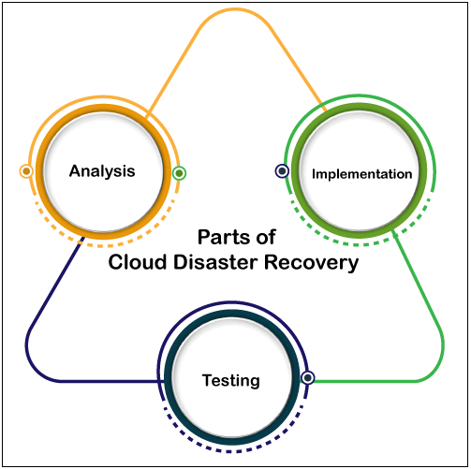

Slide 9
5.What is Disaster Recovery as a Service?
Disaster Recovery as a Service (DRaaS) is disaster recovery hosted by a third party. It involves replication and hosting of physical or virtual servers by the provider, to provide failover in the event of a natural disaster, power outage, or other disaster that affects business continuity.
The basic premise of DRaaS is that In the event of a real disaster, the remote vendor, which typically has a globally distributed architecture, is less likely to be impacted compared to the customer. This allows the vendor to support the customer in a worst case disaster recovery scenario, in which a disaster results in complete shutdown of the organization’s physical facilities or computing resources.
Third-party DRaaS vendors can provide failover for on-premise or cloud computing environments, billed either on-demand, according to actual usage, or through ongoing retainer agreements. DRaaS requirements and expectations are typically recorded in service level agreements (SLAs).

Slide 10
DRaaS Operating Models
There are three primary models used by disaster recovery as a service providers—managed, assisted, and self-service.
Managed DRaaS
In the managed DRaaS model, third parties take full responsibility for disaster recovery. Choosing this option requires organizations to work closely with DRaaS providers to keep all infrastructure, application, and service changes up to date. If you don’t have the expertise and time to manage your own disaster recovery, this is the best option.
Assisted DRaaS
If you want to take responsibility for certain aspects of your disaster recovery plan, or if you have custom applications that may be difficult for a third party to take over, supported DRaaS may be a better choice. In this model, the service provider provides services and expertise that can help optimize the disaster recovery process, but the customer is responsible for implementing some or all of the disaster recovery plans.

Slide 11
Self-Service DRaaS
The cheapest option is a self-service DRaaS, where customers are responsible for planning, testing, and managing disaster recovery, and the vendor provides backup management software, and hosts backups and virtual machines in remote locations. This model is offered by all major cloud providers—Amazon, Microsoft Azure and Google Cloud.
When using this model, careful planning and testing is required to ensure that operations can be immediately failed over to the vendor’s remote data center, and easily recovered when local resources are restored. This option is ideal for organizations with in-house disaster recovery and cloud computing expertise.

Slide 12
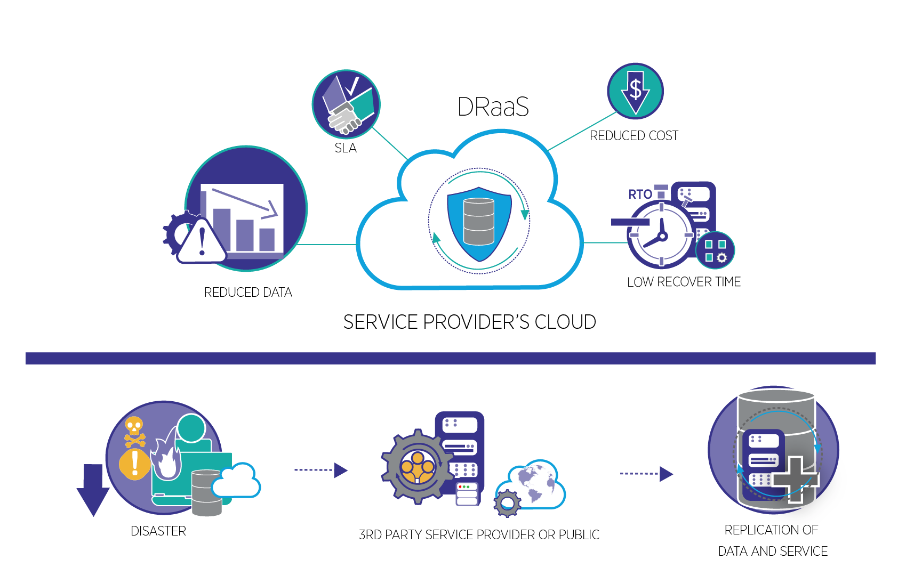

Slide 13
Conclusion
We have seen the All the types of disaster recovery with IBM virtual cloud services.
These are all the development and plans for disaster recovery with virtual cloud servers

